Slide 1
How Do We Tackle the Issue of Gun Control
Cole Woods

Slide 2
The Problem Statement
How do we focus new laws in order to begin to tackle the issue of gun related violence?
Based on the conclusions I’ve made after visualizing the data new laws should be implemented as soon as possible/for testing in the cities of Houston, Philadelphia, Baltimore, and Detroit and the age requirement to buy a gun should be raised to 21.

Slide 3
What Data am I Working With?
List of each gun related crime from January 1, 2013 to January 1, 2018, which includes the following data I used:
What type of person was involved in the incident, whether it be a suspect or victim.
Number of deaths caused in the incident
City where the incident took place
Age of the people involved in the incident.

Slide 4
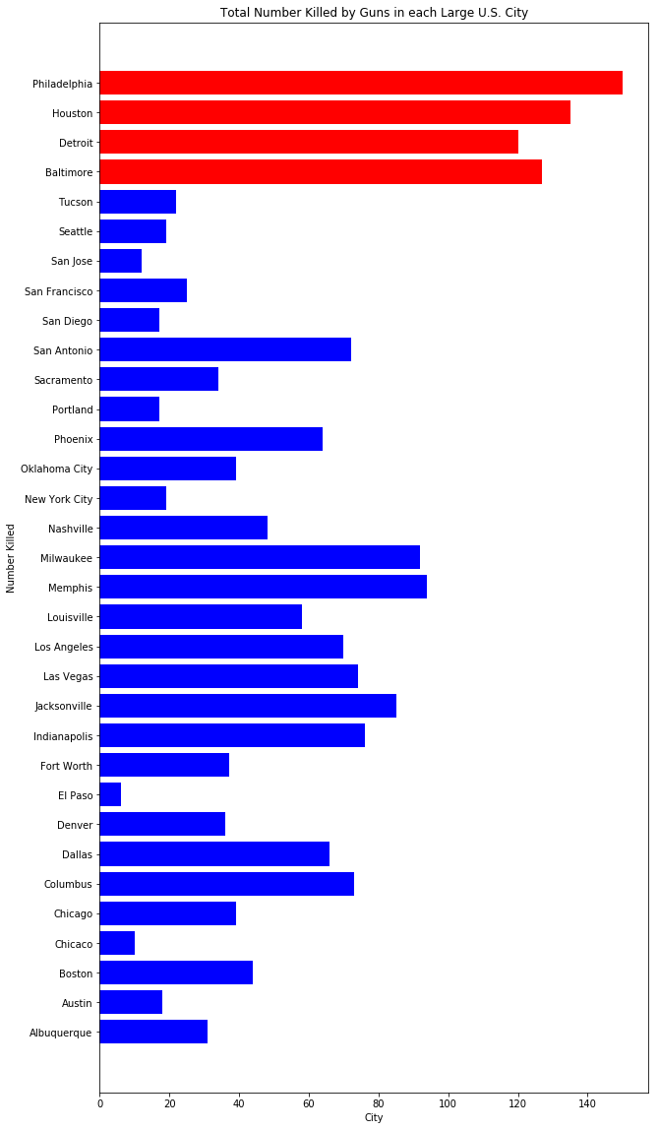
Visualizing Gun Related Deaths by City

Slide 5
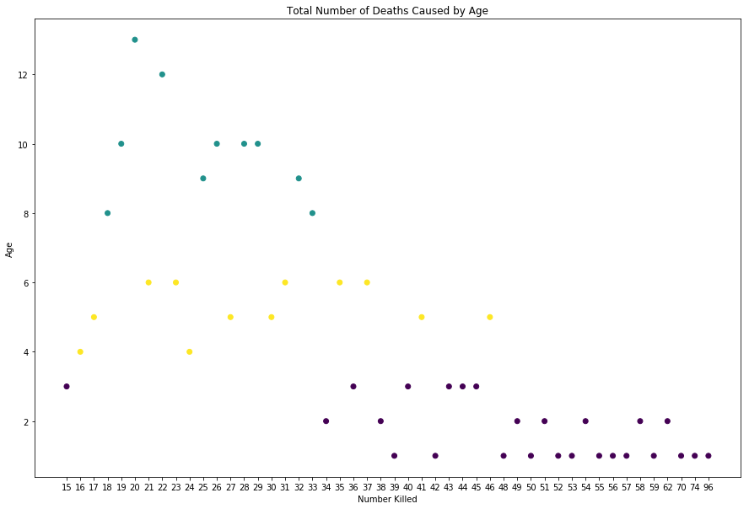
Visualizing Gun Related Deaths Caused by Each Age

Slide 6
Conclusions from the Data
There were plenty of cities with a substantial amount of gun related deaths.
Four cities in Houston, Baltimore, Philadelphia and Detroit stand out as the seemingly most dangerous and are the only ones with over 100 gun related deaths.
The ages of 19 and 20 stick out as causing the most gun related deaths
Based on the just stated point my theory is that people just out of high school who are new to being on their own are more likely to make the poor decisions resulting in gun related violence.
Based on the theory just stated I believe the gun age requirement should be raised to 21.

